Slide 1

SPRING CORE

Slide 2

Inversion of Control
Spring IoC (Inversion of Control) Container is the core of Spring Framework. It creates the objects, configures and assembles their dependencies, manages their entire life cycle. The Container uses Dependency Injection(DI) to manage the components that make up the application.
Notes:
Bean Definition: In Spring, the objects that form the backbone of your application and that are managed by the Spring IoC container are called beans. A bean is an object that is instantiated, assembled, and otherwise managed by a Spring IoC container.
Spring container primary functions –
Create and manage objects(Inversion of control)
Inject object’s dependency (Dependency injection)
Three ways for configuring spring container –
XML configuration file(legacy, but most legacy apps still use this.)
Java Annotations(modern)
Java source code(modern)

Slide 3
Concept involved
In typical OOP approach,we have MyApp class dependent on the HockeyCoach,BaseballCoach,CricketCoach class.Here we have main method in MyApp class and we have Coach.java as an interface which have a function getDailyWorkout() and for this method there is different implementation in HockeyCoach,BaseballCoach and CricketCoach as they are implementing the interface Coach.java.
BaseballCoach
MyApp
CricketCoach
HockeyCoach

Slide 4
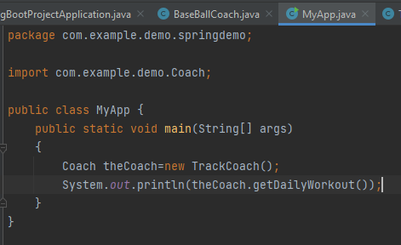
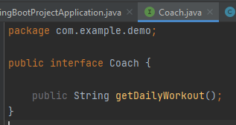
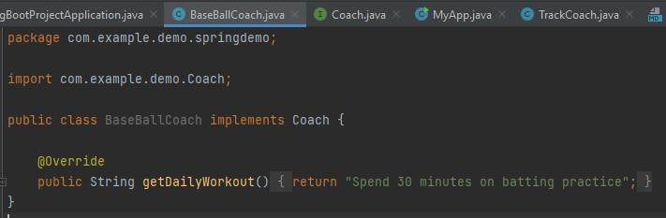
Notes:
We have to create the CricketCoach and CricketCoach file in the same way we have created the BaseBall file only the implementation inside the getDailyWorkout() function will be different and we can call
Them in the same way that we have called TrackCoach in the second screenshot.

Slide 5
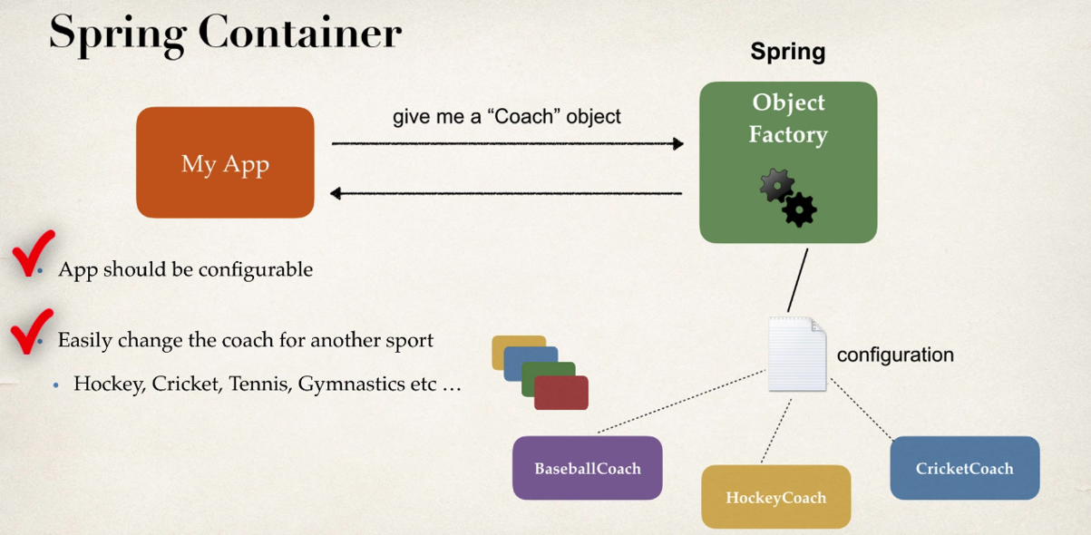
IOC Approach
Notes:
First, we will see by XML configuration

Slide 6
IOC and Dependency Injection using XML configuration file

Slide 7
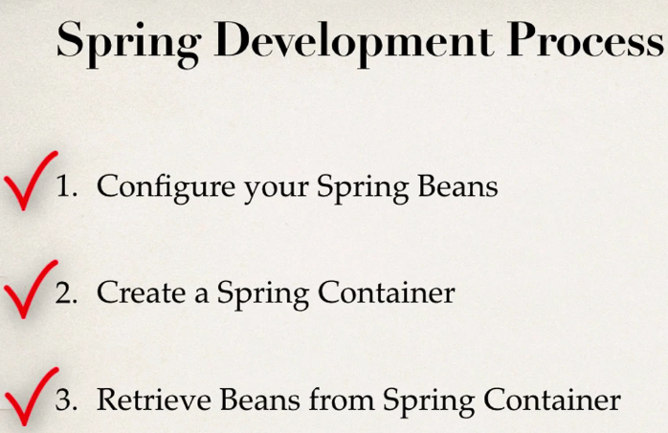

Slide 8
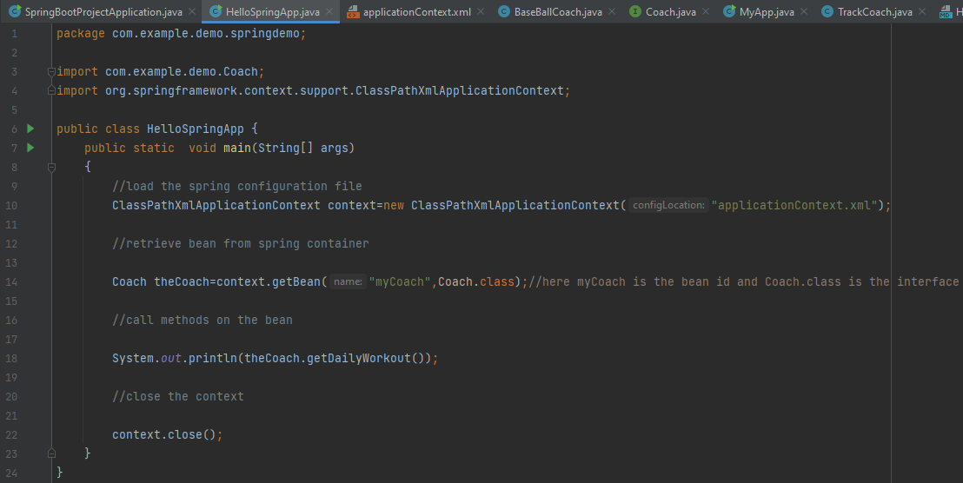
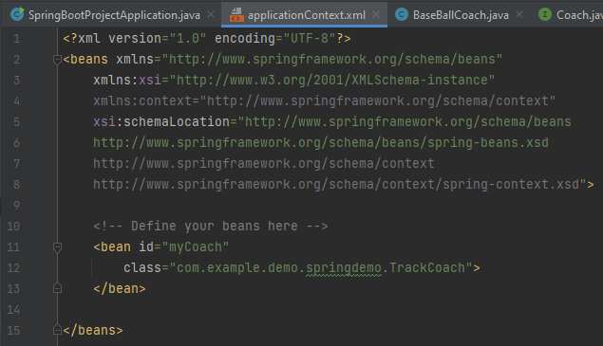
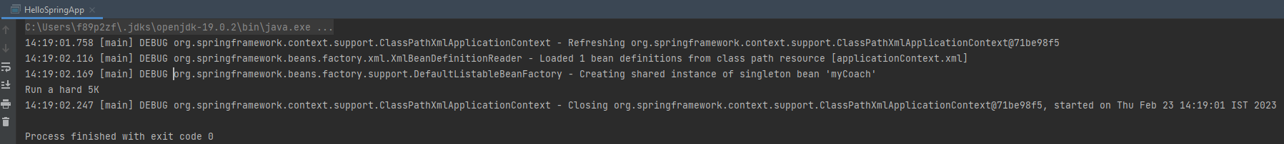
Code
Notes:
Issue was coming while loading the spring configuration file i.e. applicationContext.xml, so if we are using maven then place it in the resources folder that is there in src/main in place of keeping it in src folder .
Now we have removed the dependency of HelloSpringApp file from the different class files i.e. BaseballCoach or TrackCoach.Now we just need to change the class name in configuration file.In the above screenshot we have it as TrackCoach,we can change it to BaseballCoach or any of the class file names.
Question
Why do we specify the Coach interface in getBean()?
For example:
Coach theCoach = context.getBean("myCoach", Coach.class);
---
Answer
When we pass the interface to the method, behind the scenes Spring will cast the object for you.
context.getBean("myCoach", Coach.class)
However, there are some slight differences than normal casting.
From the Spring docs:
Behaves the same as getBean(String), but provides a measure of type safety by throwing a BeanNotOfRequiredTypeException if the bean is not of the required type. This means that ClassCastException can't be thrown on casting the result correctly, as can happen with getBean(String).

Slide 9
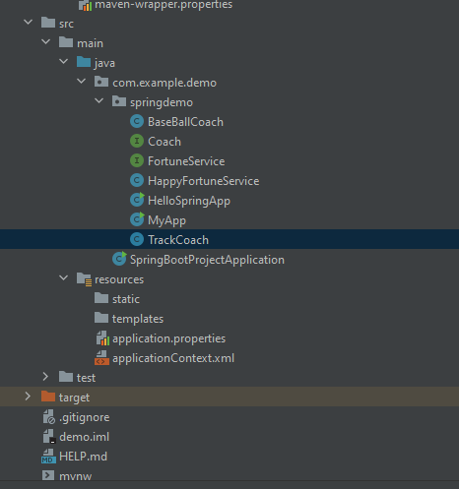
Project folder configuration
Notes:
Initial configuration of applicationContext.xml file was taken from the downloaded codes given by the instructor.

Slide 10
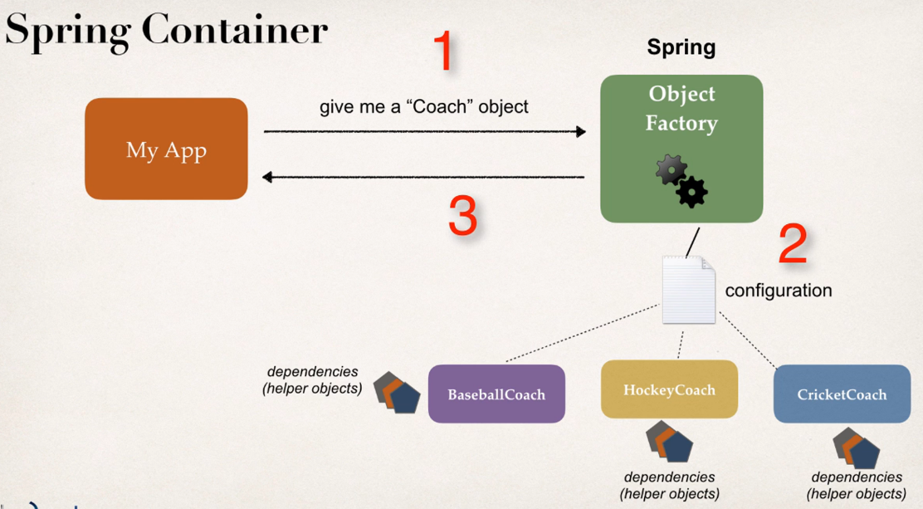
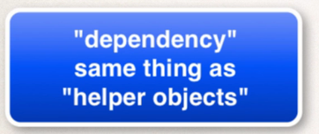
Dependency Injection
The spring framework serving as a dependency injection binds together the classes of your application with the help of the instructions provided by you, which can be provided as annotations in the code or by explicitly binding the configuration code or by using an XML configuration.

Slide 11
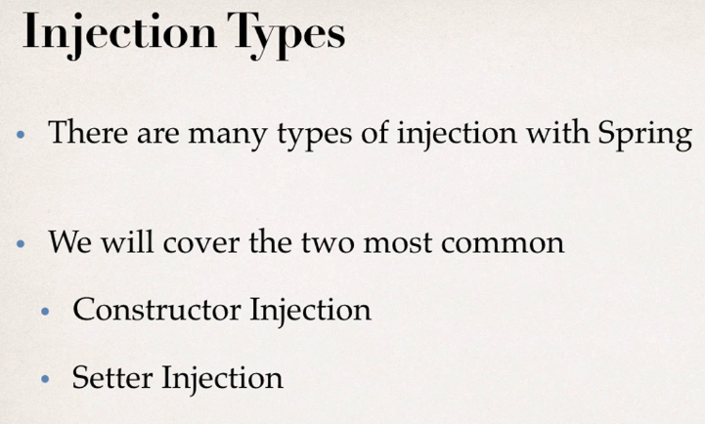
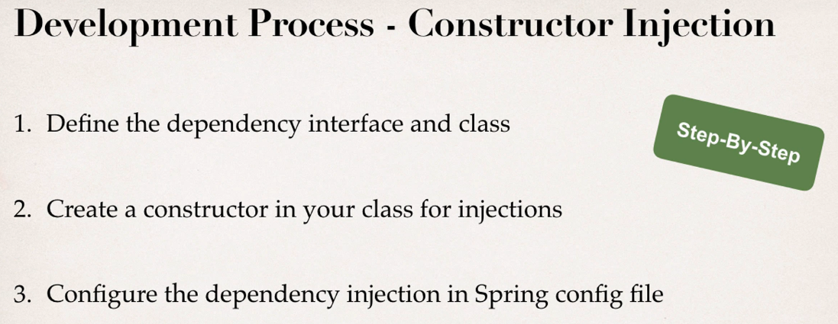
Notes:
One more type is there i.e. @AutoWiring which we discuss in the annotations section.

Slide 12
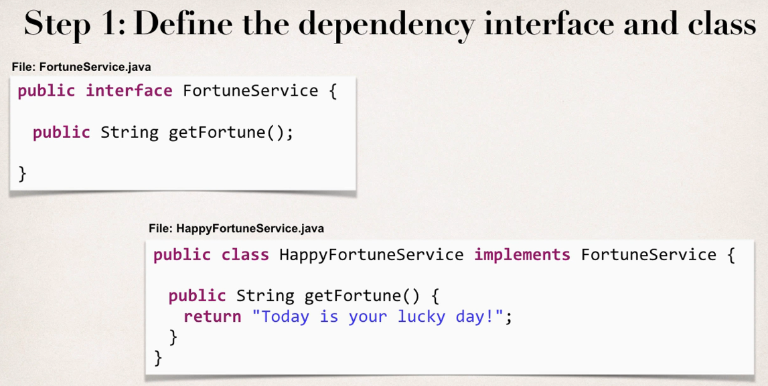
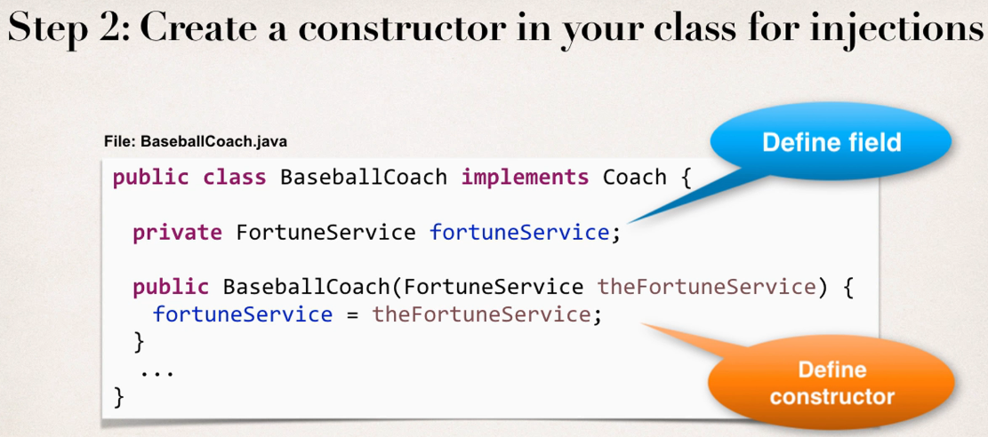
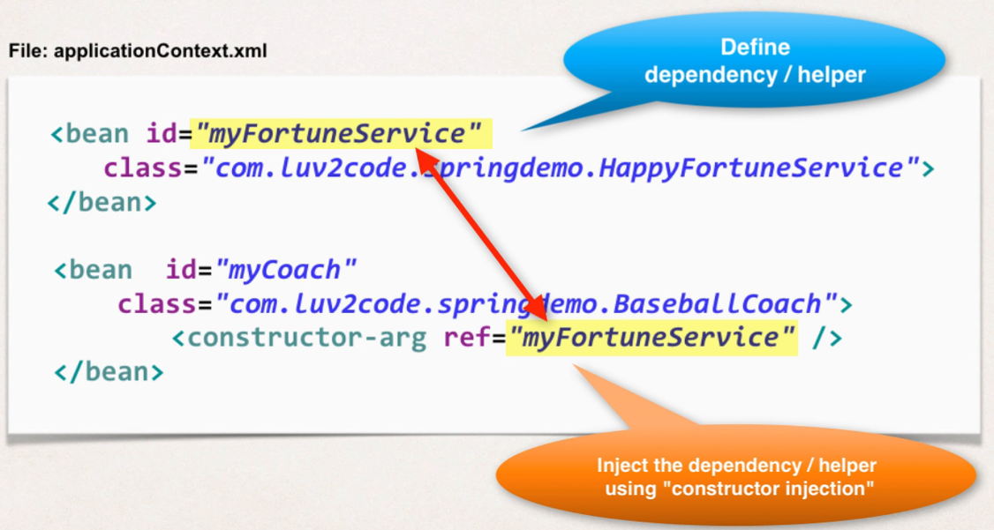

Slide 13
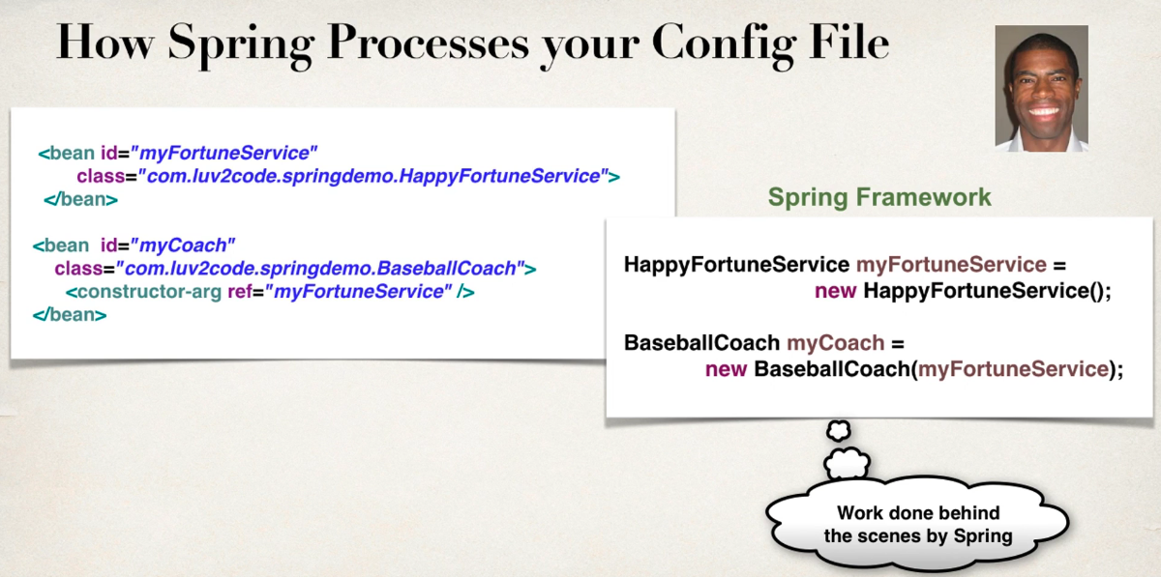
Constructor Injection
Notes:
Constructor Injection is the act of statically defining the list of required Dependencies by specifying them as parameters to the class's constructor.

Slide 14
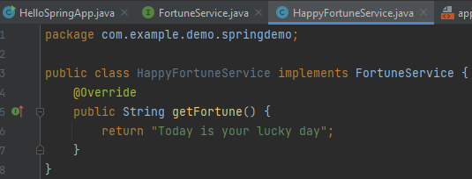
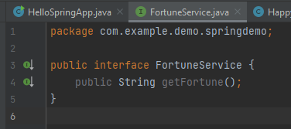
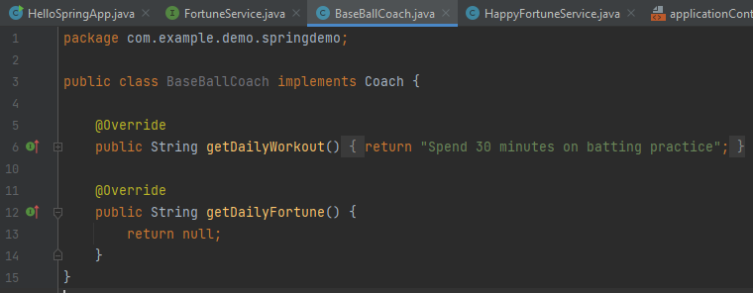
Step – 1 Defining dependency interface and class
Notes:
Similarly, we will define getDailyFortune in other files too i.e. in TrackCoach,HockeyCoach

Slide 15
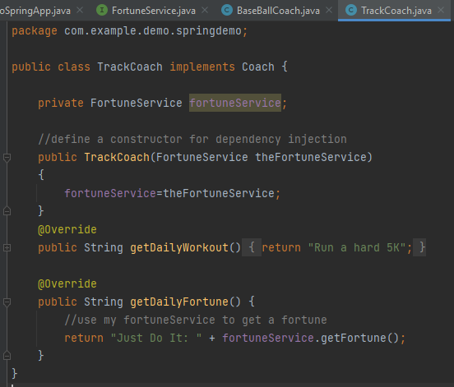
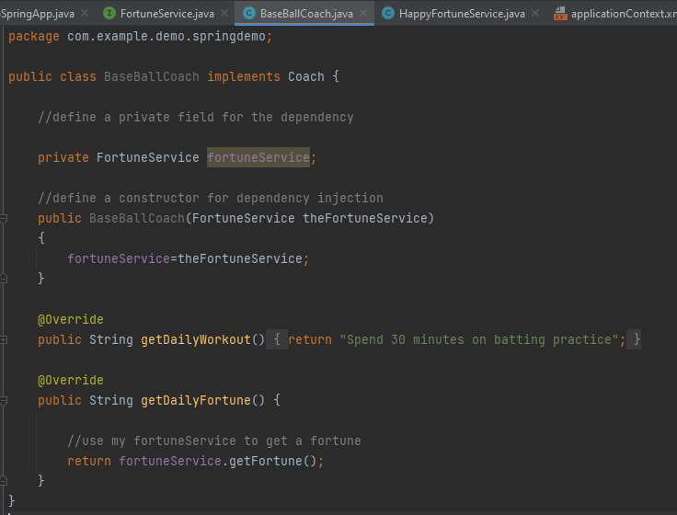
Step - 2 Create a constructor in your class for injection

Slide 16
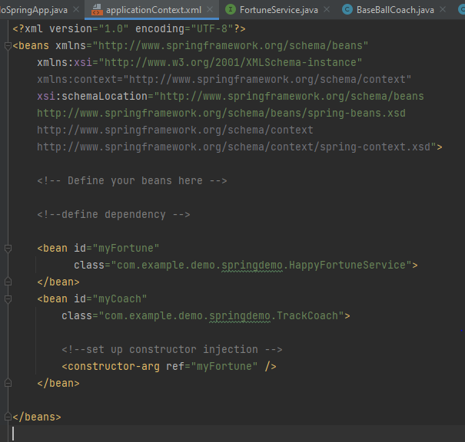
Step - 3 Configure the dependency injection in Spring config file
Notes:
In the above Screenshot in class,we can pass BaseballCoach in place of TrackCoach as well

Slide 17
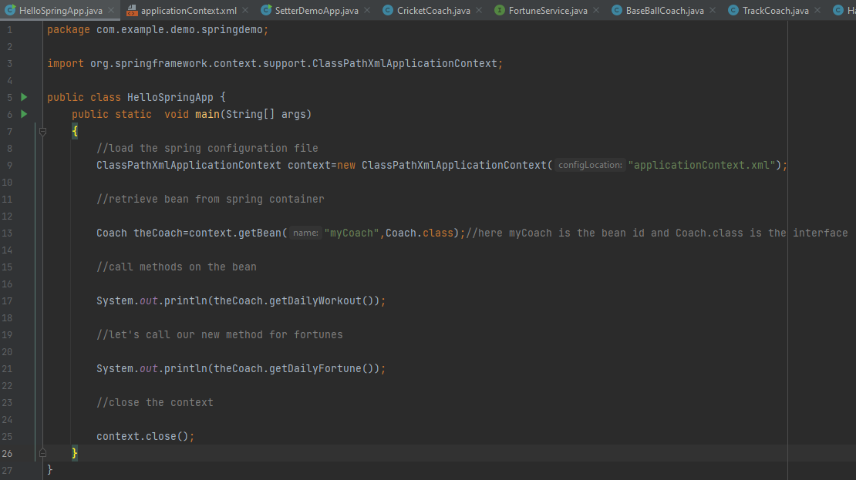
Notes:
Here we have to run our code i.e. which contains main method

Slide 18
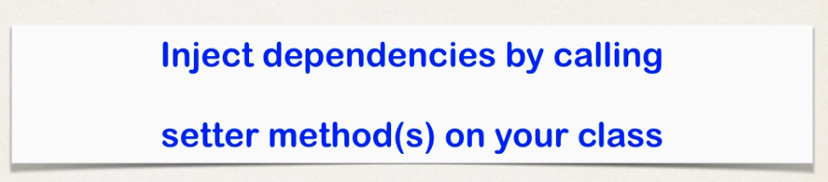
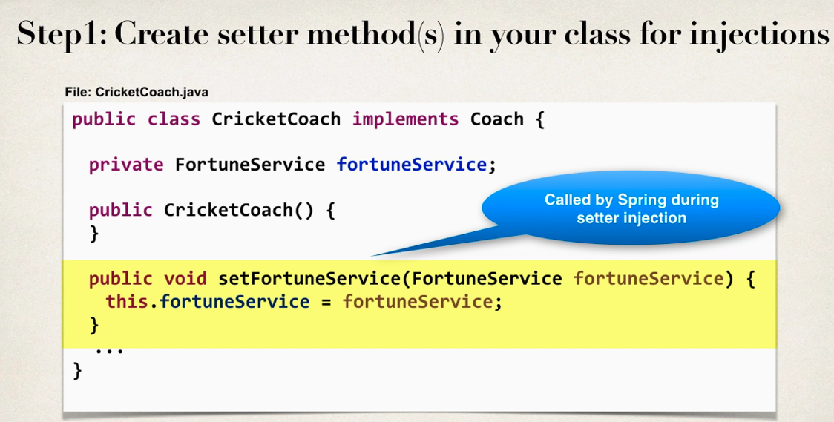
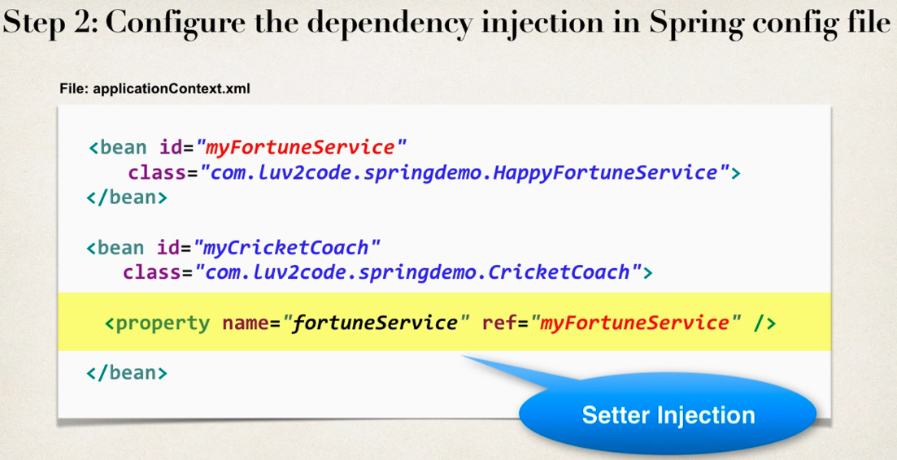
Setter Injection

Slide 19
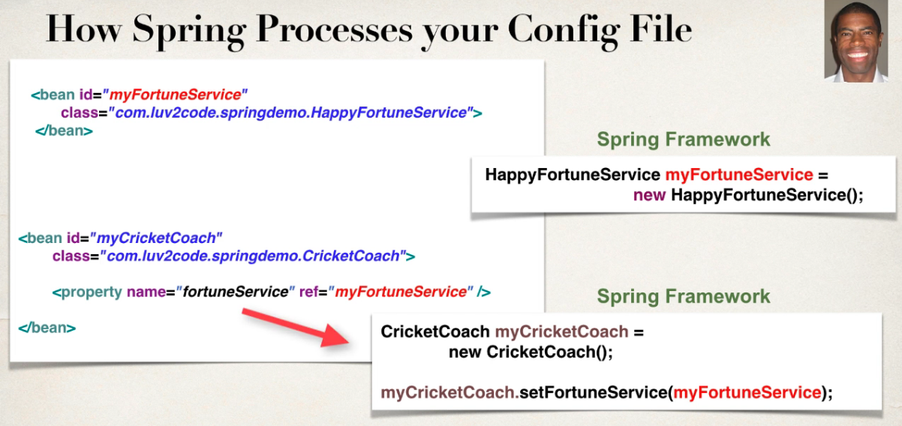

Slide 20
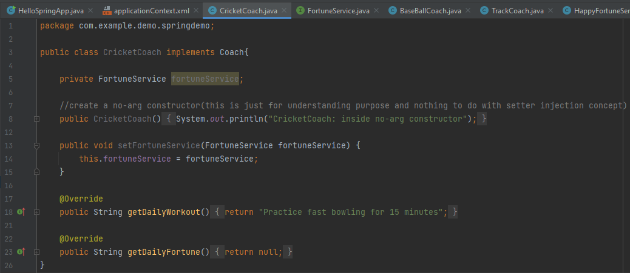
Step – 1 Create setter methods in your class for injection

Slide 21
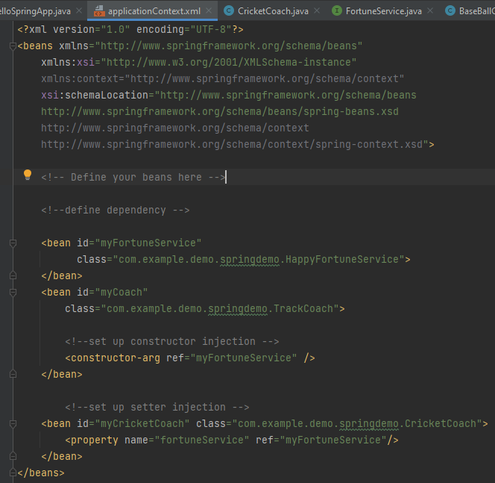
Step – 2 Configure the dependency injection in Spring config file

Slide 22
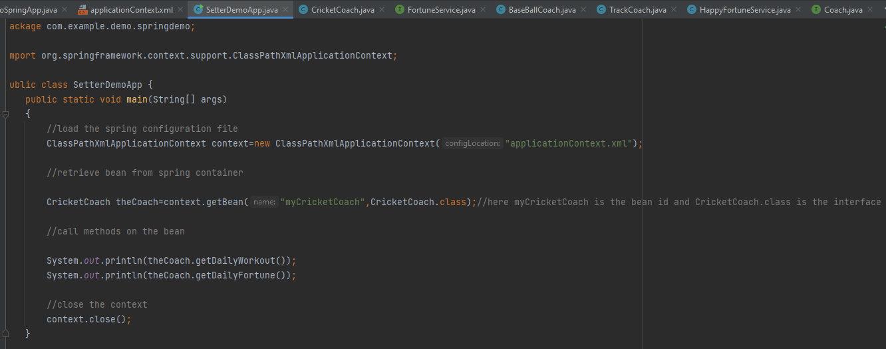
Notes:
Here we have to run our code i.e. which contains main method

Slide 23
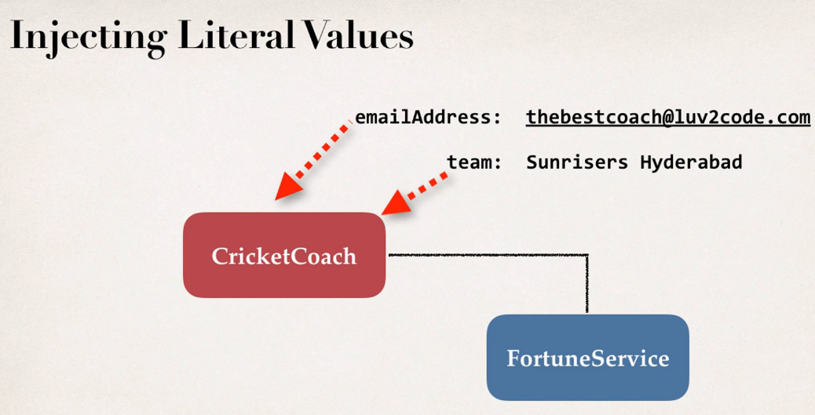
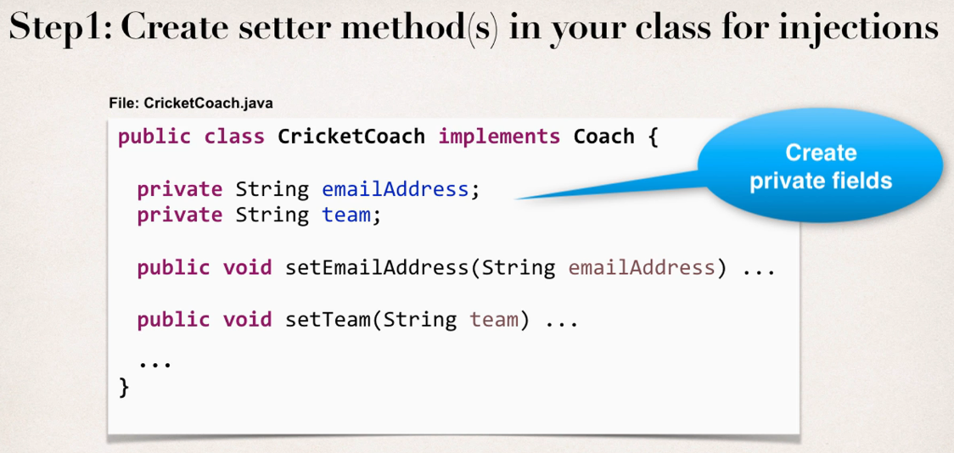
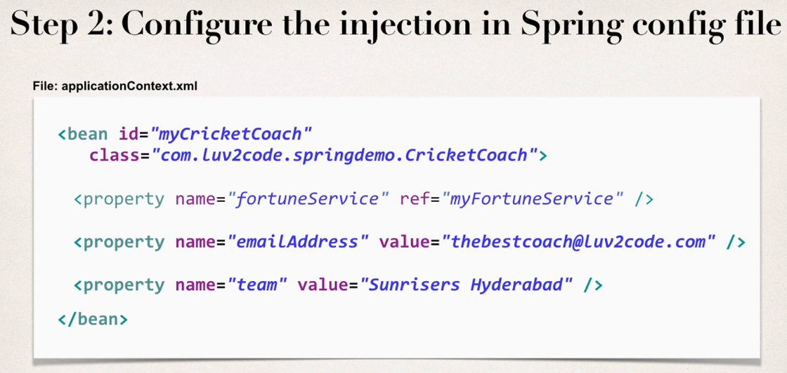
Injecting literal values

Slide 24
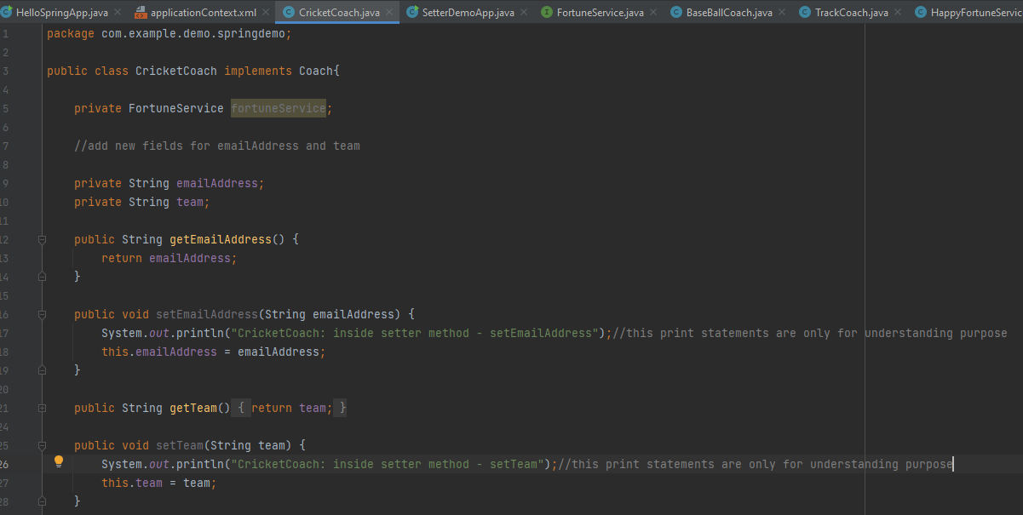
Step - 1- Create setter method in your class for injection

Slide 25
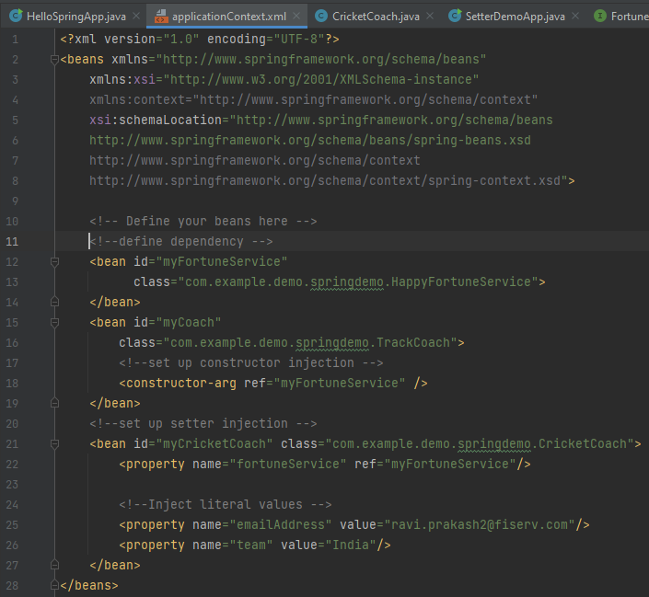
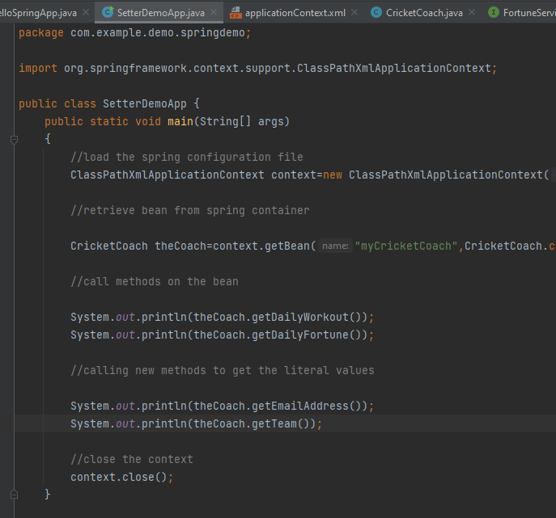
Step - 2- Configure the injection in spring config file

Slide 26
If we see SetterDemoApp on slide number 22
Why do we use CricketCoach class instead of Coach Interface?
Question:
For the CricketCoach example with Setter Injection, why do we use the CricketCoach class instead of the Coach interface?
Answer:
The getTeam() method is only defined in the CricketCoach class. It is not part of the Coach interface.
As a result, you would need the following code:
CricketCoach theCricketCoach = context.getBean("myCricketCoach", CricketCoach.class);
---
The Coach interface has two methods: getDailyWorkout and getDailyFortune
The CricketCoach class has four methods: getDailyWorkout, getDailyFortune, getTeam and setTeam
---
When you retrieve a bean from the Spring container using the Coach interface:
Coach theCricketCoach = context.getBean("myCricketCoach", Coach.class);
You only have access to the methods defined in the Coach interface: getDailyWorkout and getDailyFortune. Even though the actual implementation has additional methods, you only have visibility to methods that are defined at the Coach interface level.
---
When you retrieve a bean from the Spring container using the CricketCoach class:
CricketCoach theCricketCoach = context.getBean("myCricketCoach", CricketCoach.class);
You have access to the methods defined in the Coach interface: getDailyWorkout and getDailyFortune.
ALSO, you have access to the additional methods defined in the CricketCoach class: getTeam, setTeam.
---
The bottom line is it depends on how you retrieve the object and assign it ... that determines the visibility you have to the methods.

Slide 27
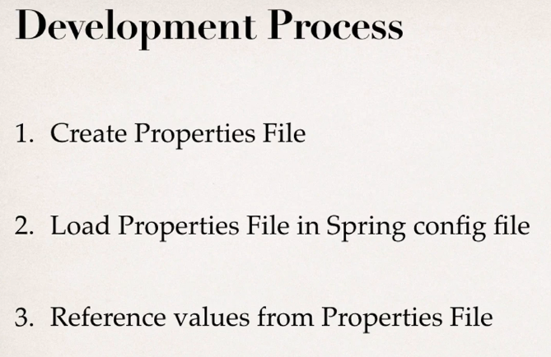
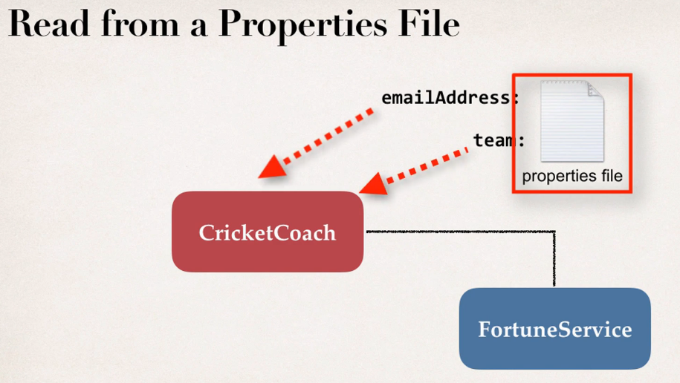
Injecting values from the applicationContext.xml file or properties file

Slide 28
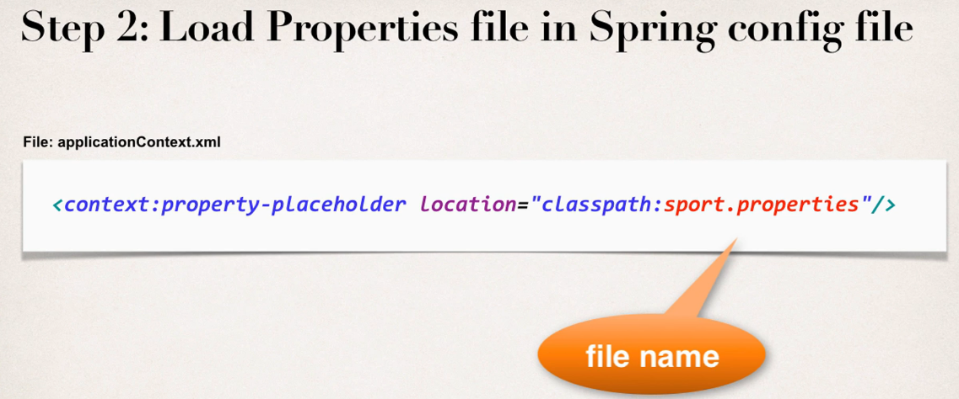

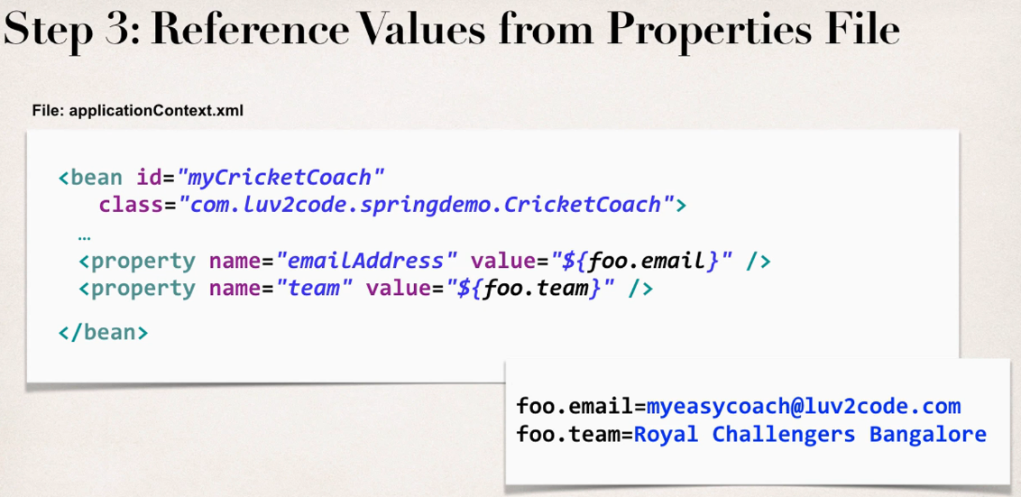

Slide 29
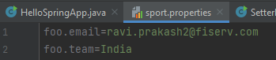
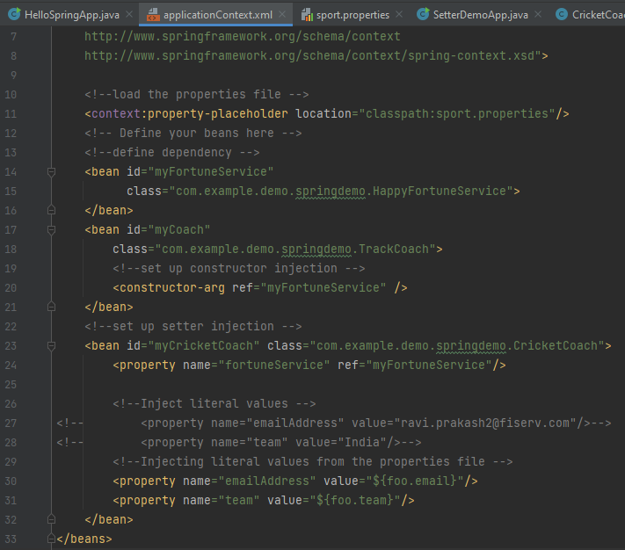
Notes:
We can’t give multiple property definition to a same property that’s why I have commented the code which were previously for injecting the literal values.We were getting error as –
Configuration problem: Multiple 'property' definitions for property 'emailAddress’
For the above code SetterDemoApp file will be exactly same as we have written for Injecting literal values
<context:property-placeholder location="classpath:sport.properties"/> //this line we have added in applicationContext.xml file.
Now literal values are not hard coded,we have made it flexible by including the file sport.properties.Now whatever we will change in sport.properties file it will get reflected in the output

Slide 30
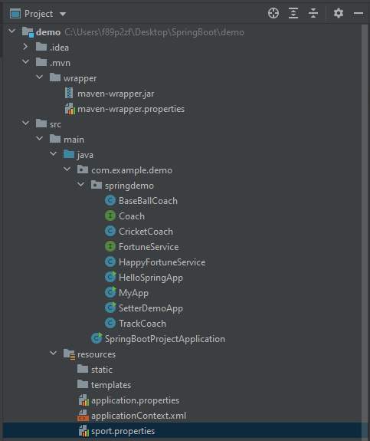
Folder structure
Notes:
sport.properties file must be placed in resources

Slide 31

Thank You
RAVI.PRAKASH2@FISERV.COM
Notes:
https://medium.com/analytics-vidhya/dependency-injection-concept-of-spring-framework-d9c3688005f8

